Slide 1
Arabizi Language Detection
Natural Language Processing

Slide 2
Preprocessing

Slide 3
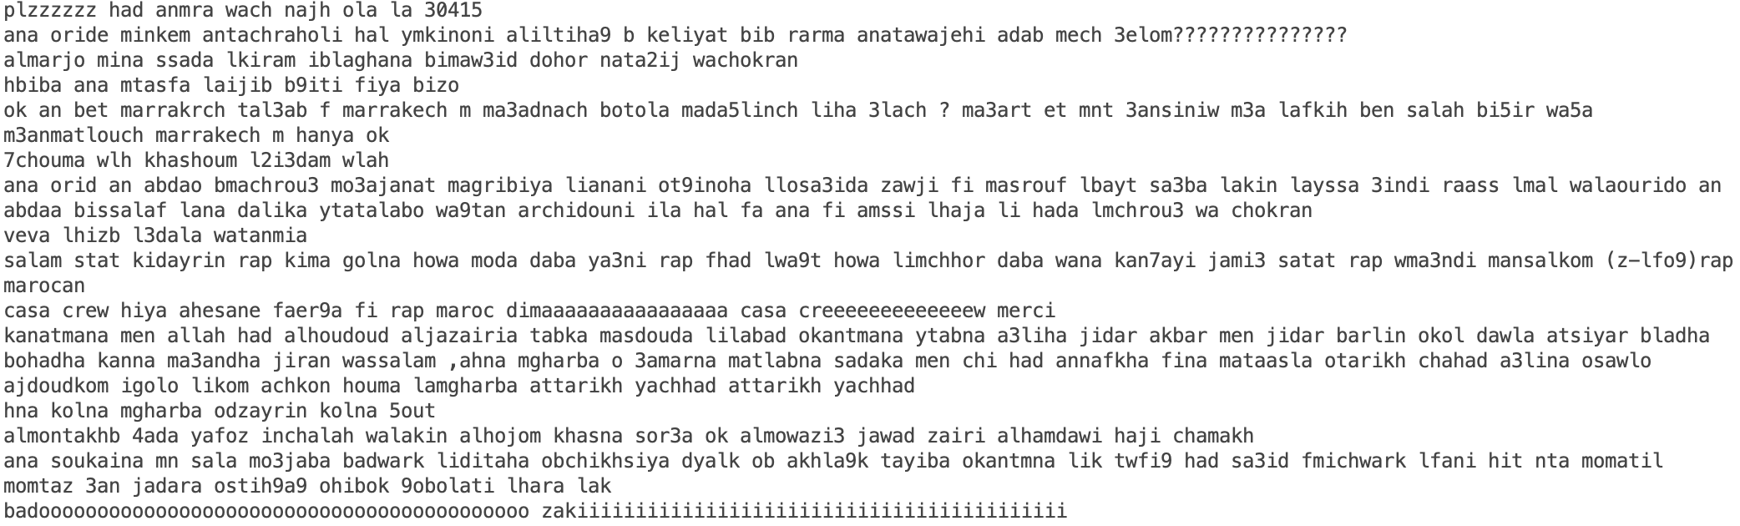
Removal of “Punctuation!!!!” Removal of Reepeated Characterssssss….

Slide 4
Insufficient Data: Solutions
Corpus | Advantage | Disadvantage
Brown Corpus: Corpus containing million words curated in 1961. | Contains millions of English words | Created in 1961. Too old for our purpose.
Gutenberg Corpus: 25000 electronic books | Wide range of words can be included. Almost everything used in English. | Not domain(Chat application/web) specific
Web and Chat Text Corpus: Collected from Firefox discussion forum on review of PoC, wine in 2006. | Suits our need. | The corpus was made in 2006. The lingo has changed since.
Twitter Dataset: Custom made in 2019 that include specific topic Arab politics. | It suits our need, can be tailored to be more relevant and freshly made. | Only past 7 days of tweets can be fetched for free.

Slide 5
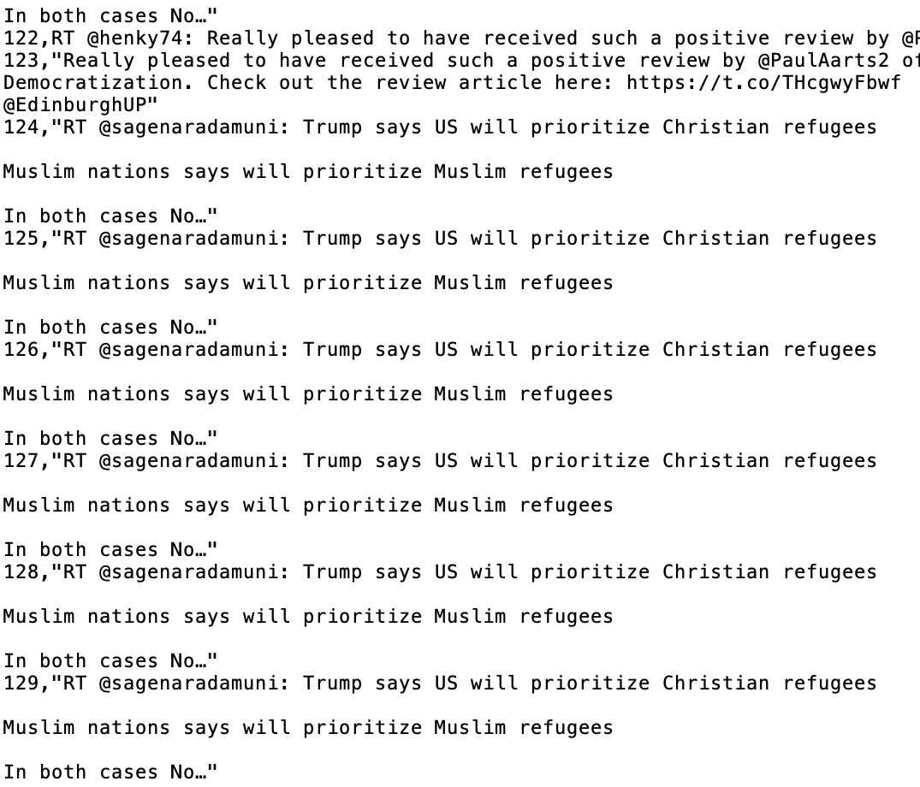
Challenges with Twitter Dataset
Repeated tweets: This will introduce a bias in training set.
Solution?

Slide 6
Twitter Data fetch

